Slide 1
Orphanage Management System Developed in PHP & MySQL

Slide 2
Abstract
Although the people with helping mind in today’s era are less, there are also people who are concerned about the well-being of elderly people and orphans, who are left out by their families or abandoned. So, this paper is about the web application which involves the process of finding a home or an orphanage for the needy. The process of web application starts with the person (who is ready to help) can login to the page and register by entering the details of orphans and the old people. Then the application searches for the orphanage with available vacancy and facilities. The Administrator of the website will be able to see the details of the needy. And, their responsibility of maintaining a database of the information of registered people will be the admin’s job. Also, constantly updating the database is important, in case of any adoption or any other reason for removing the person from the database.
Our project explains about the orphanage management system. This project provide the details of orphan child and adopter sent adoption request which they want to adopt This project shows some ease in adding, editing and deleting the child details, news details and website details. It also provides a less time consuming process for viewing, adding and editing the child details, news details and website details.

Slide 3
Introduction
Orphanage Management System is a web based technology which manages orphan Childs and adoption request database and provides rights to update the their details. In this web application user must be registered. This web application provides a way to effectively control record & track the adoption request details and child details.
Orphanage Management System is software which is helpful for users as well as the orphanage authority. In the current system all the activities are done manually. It is very time consuming and costly. Our Orphanage Management System deals with the various activities related to the orphanage group.
In this project we use PHP and MySQL database and it has two module i.e. Admin and Users
Advantages:
It helps the admin to handle and manage child data and request data.
Reduce time consumption.
Reduce error scope.
All system managements are automated.
Centralized database management.
Easy operations for operator of the system.
No paper work requirement.
Disadvantages:
The system can only handle single admin.

Slide 4
Project Modules
Motive of our paper is to eliminate the drawback of previous application and to help orphans to the full extend. The system works and fulfills all the functionalities as per the proposed system.
It will provide reduced response time against the queries made by different user(foster).
All possible features such as verification, validation, security, child friendliness etc. have been considered.
In this project there is two module i.e. Admin and Users (foster)

Slide 5
Admin Module
This module provides administrator-related functionalities. The administrator manages the entire application.
Dashboard: In this section, admin can view total orphan child’s, total users(foster), total news, total new adoption request, total accepted adoption request and total rejected adoption request.
Child: In this section, admin can manage child’s (Add/Delete/Update).
Manage Users (Foster): In this section, admin can manage users (Update).
Adoption Request: In this section, admin can view the adoption request which is sent by users (foster) and they have right to accept and reject that request.
News: In this section, admin can add and delete news details which is added by administrator.
Reports: In this section, admin can generate between date and search report.
Website Setting: In this section, admin can handle website details.
Admin can also update his/her change the password.

Slide 6
User Module
This module provides, users(foster)- related functionalities. In this users must be registered.
Home: This is the welcome page for any users(fosters).
About: In this section, users can view the about us details of website.
Our Children’s: In this section, users can view the children’s details of orphanage.
My Accounts: In this section, users can his/her password, view and update his/her profile, view request history and log out from their accounts.
Contact: In this section, users can view contact details.

Slide 7
Requirement Specification
Hardware Configuration:
Client Side
Server Side
RAM | 512 MB
Hard Disk | 10GB
Processor | 1.0 GHz
RAM | 1 GB
Hard Disk | 20GB
Processor | 2.0GHz

Slide 8
Continue.....
Software Requirement:
Client Side
Server Side
Web Browser | Google Chrome or any compatible browser
Operating System | Windows or any equivalent OS
Web Server | APACHE
Server side Language | PHP5.6 or above version
Database Server | MySQL
Web Browser | Google Chrome or any compatible browser
Operating System | Windows or any equivalent OS

Slide 9
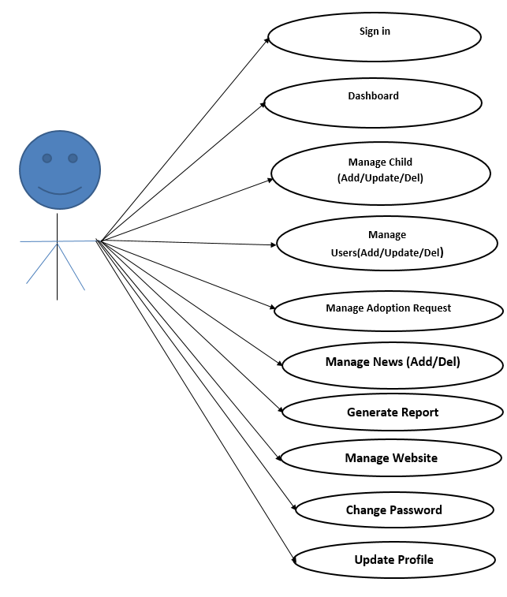
Use Case Diagram
Admin
Notes:
USECASE DIAGRAM: A Use case is a description of set of sequence of actions. Graphically it is rendered as an ellipse with solid line including only its name. Use case diagram is a behavioral diagram that shows a set of use cases and actors and their relationship. It is an association between the use cases and actors. An actor represents a real-world object. Primary Actor – Sender, Secondary Actor Receiver.

Slide 10
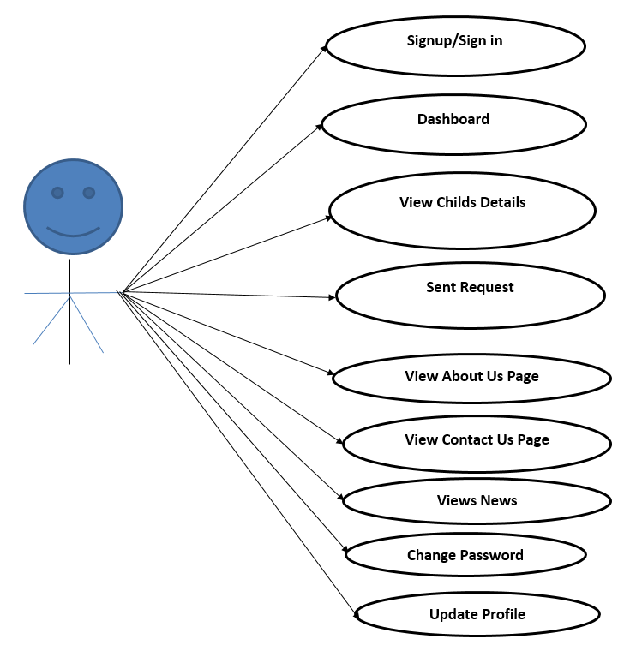
Continue…
User

Slide 11
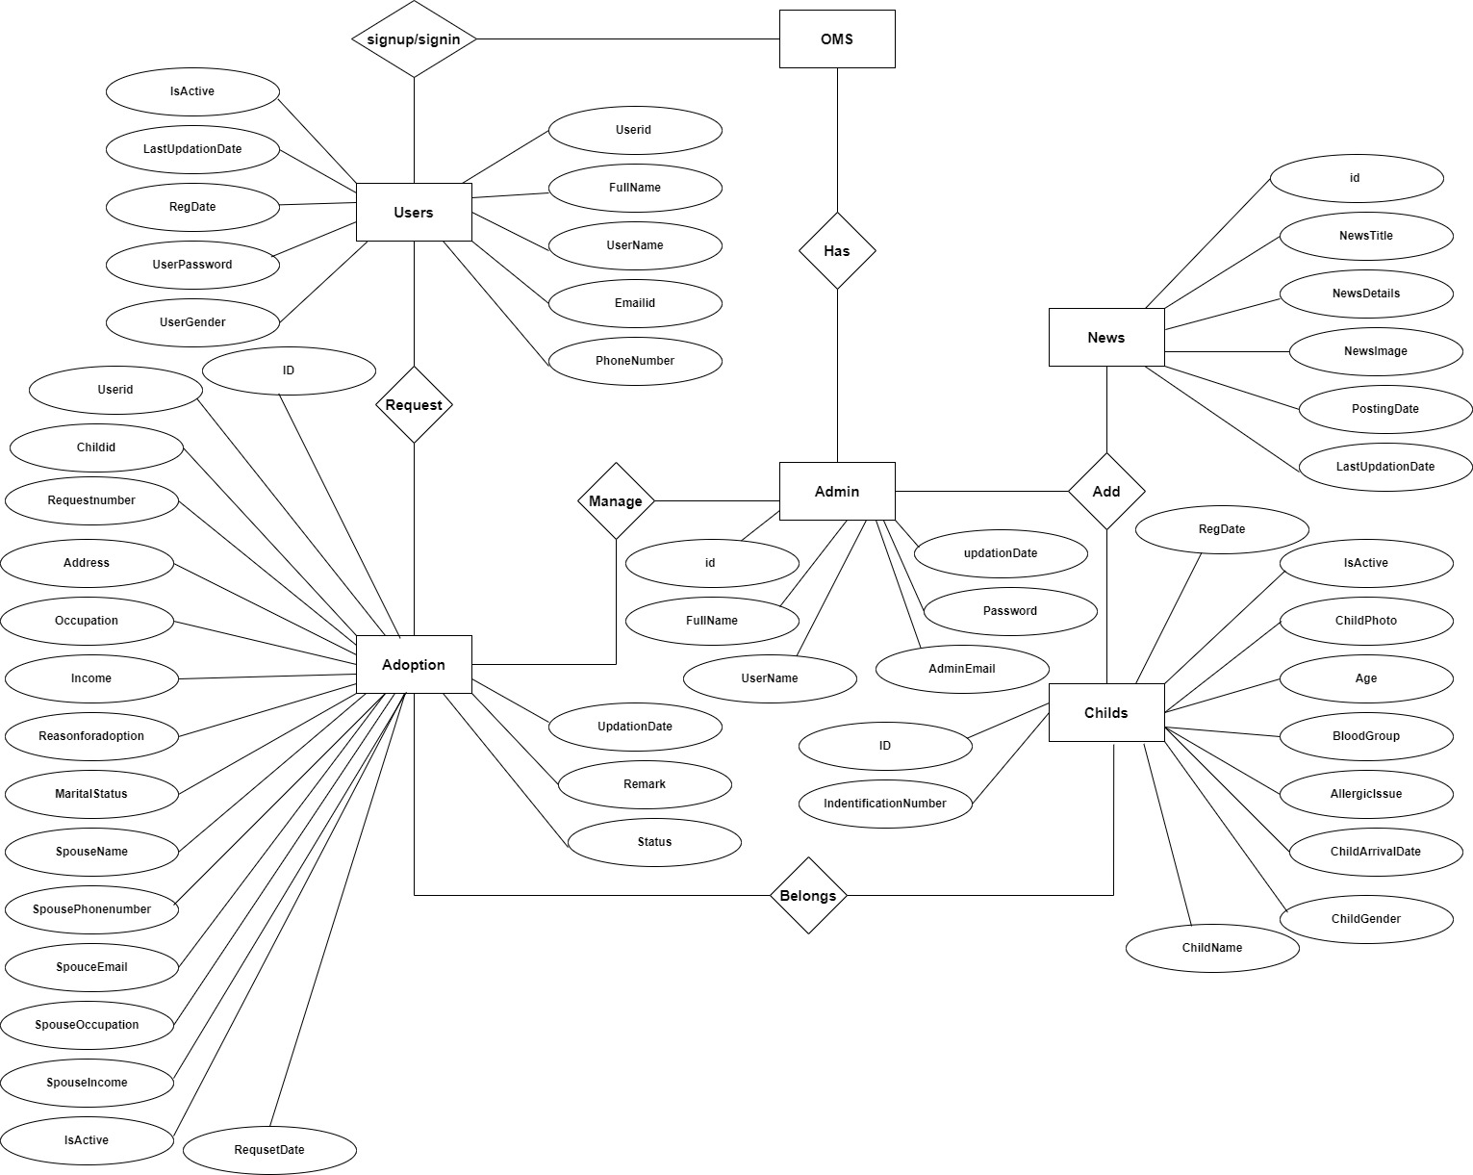
ER Diagram

Slide 12
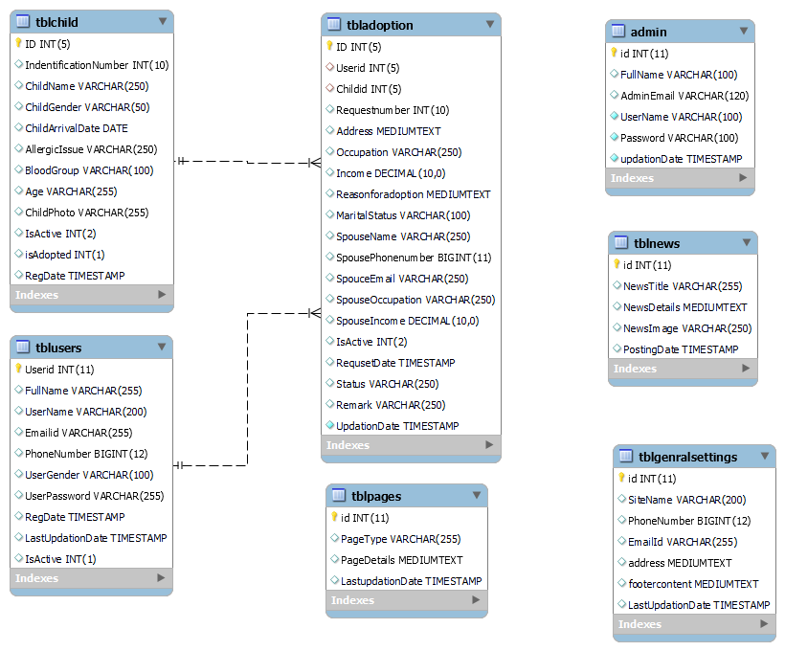
Class Diagram
Notes:
The class diagram shows a set of classes, interfaces, collaborations and their relationships.

Slide 13
Data Flow Diagrams
Data Flow Diagram
DFD graphically representing the functions, or processes, which capture, manipulate, store, and distribute data between a system and its environment and between components of a system. The visual representation makes it a good communication tool between User and System designer. Structure of DFD allows starting from a broad overview and expand it to a hierarchy of detailed diagrams. DFD has often been used due to the following reasons:
Logical information flow of the system
Determination of physical system construction requirements
Simplicity of notation
Establishment of manual and automated systems requirements

Slide 14
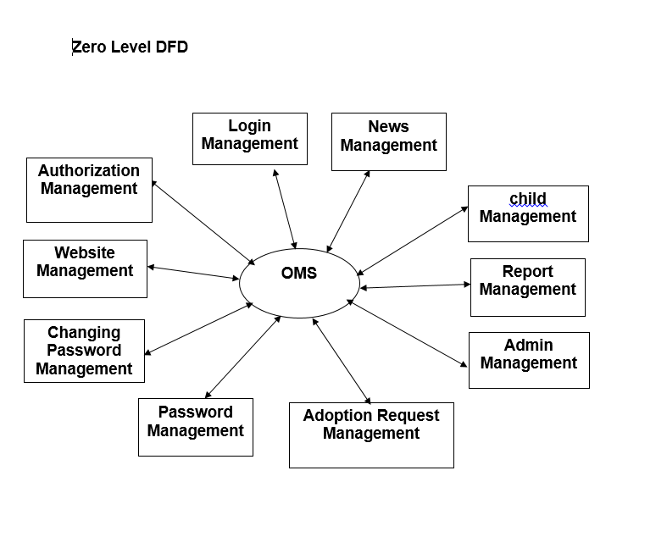

Slide 15
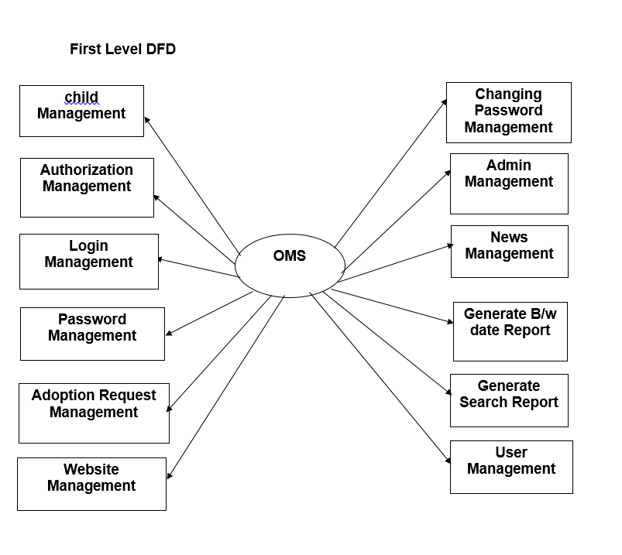

Slide 16
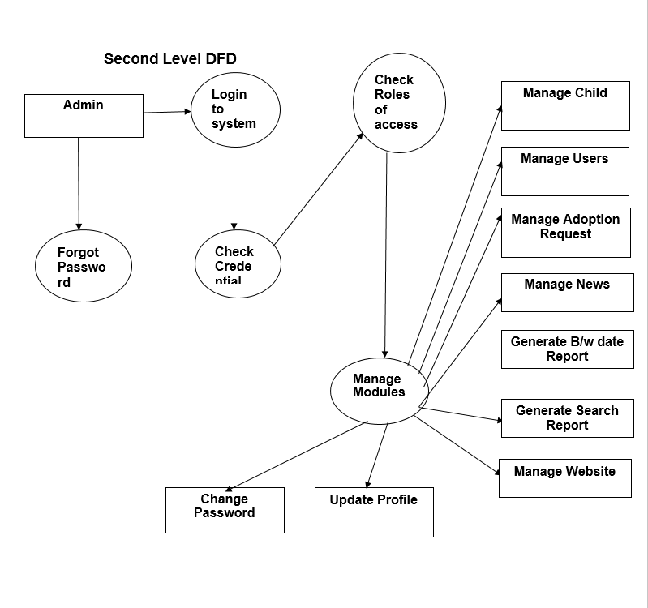

Slide 17
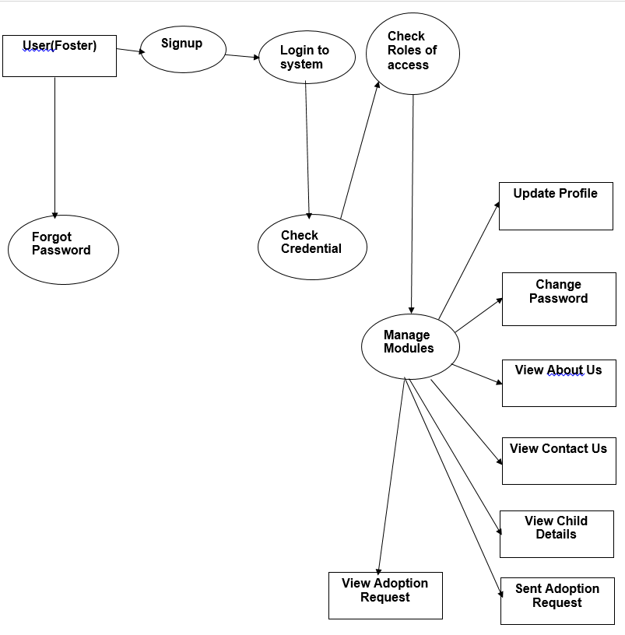

Slide 18
Implementation and System Testing
After all phase have been perfectly done, the system will be implemented to the server and the system can be used.
System Testing
The goal of the system testing process was to determine all faults in our project .The program was subjected to a set of test inputs and many explanations were made and based on these explanations it will be decided whether the program behaves as expected or not. Our Project went through two levels of testing
Unit testing
Integration testing

Slide 19
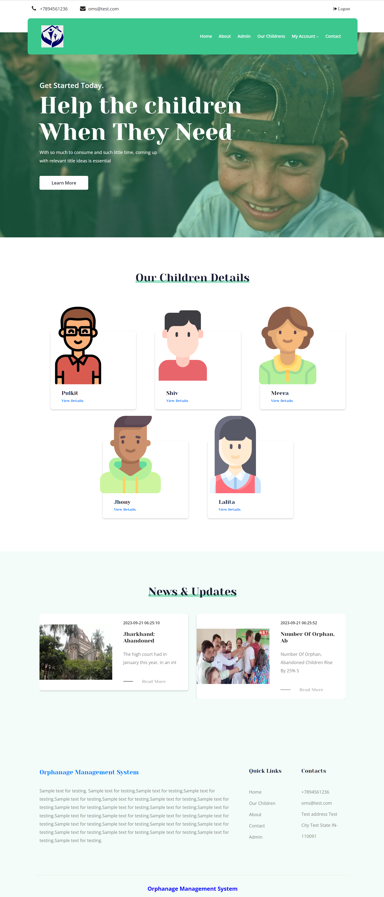
Project Screens

Slide 20
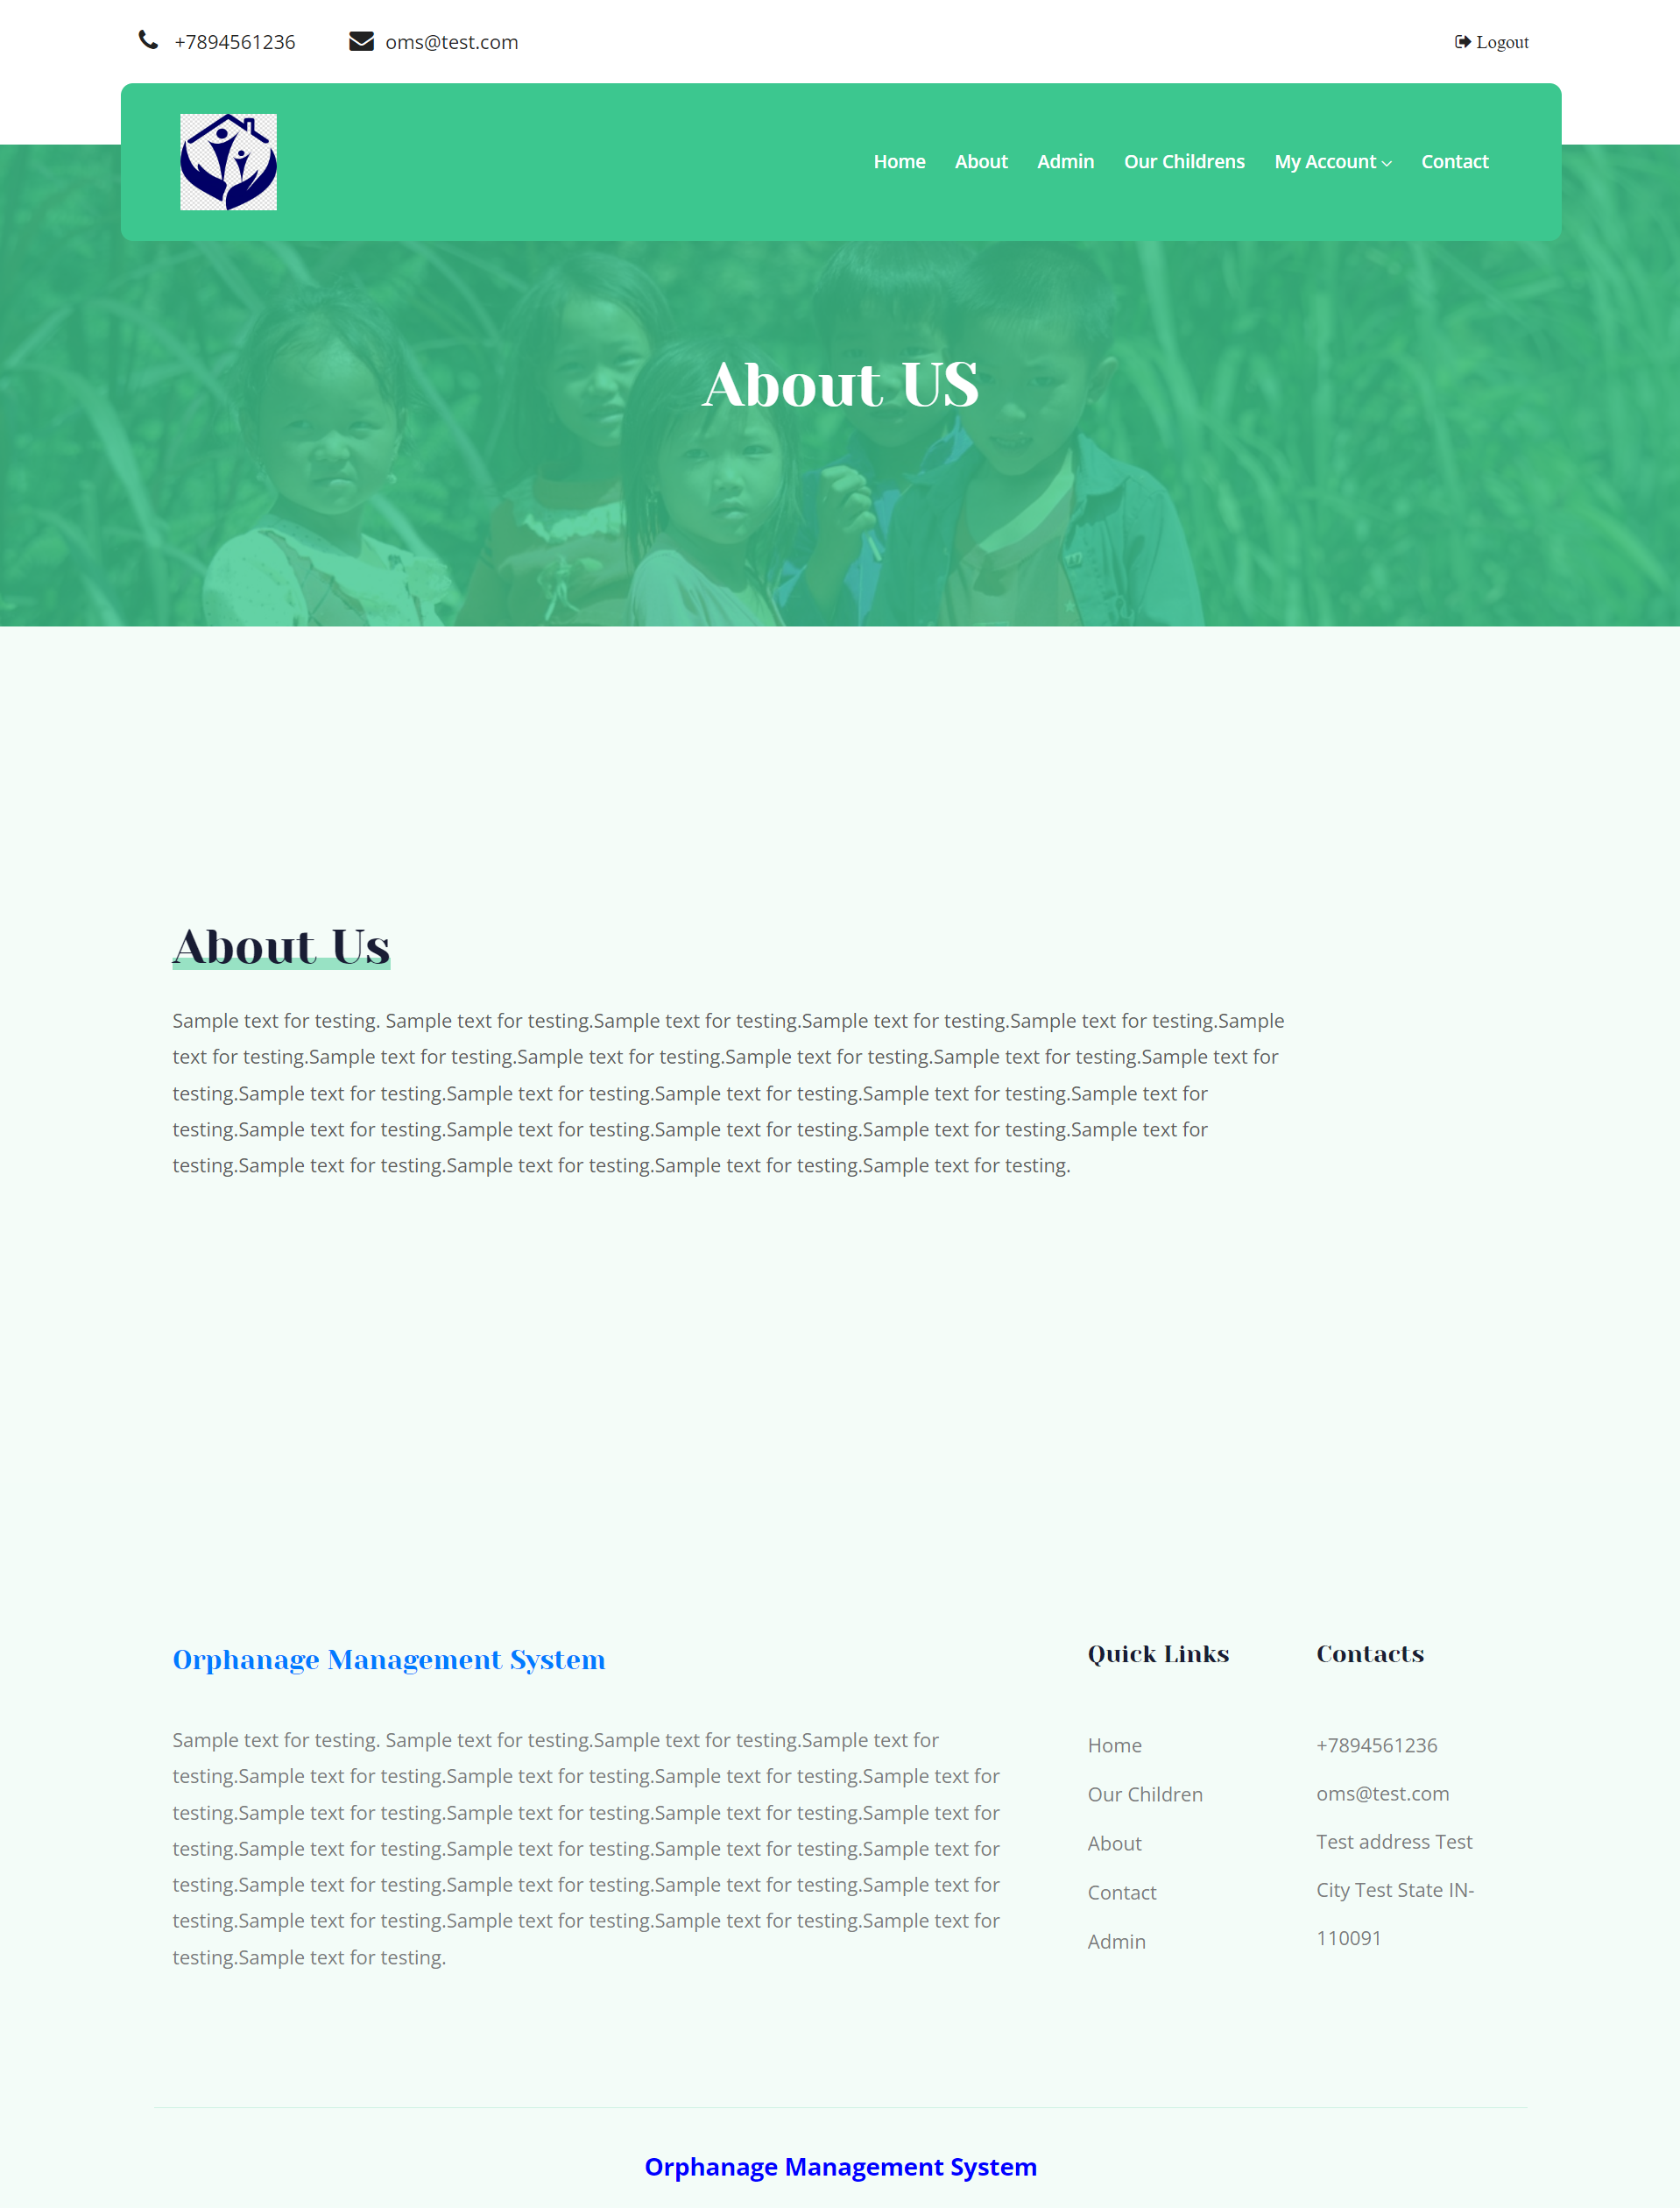

Slide 21
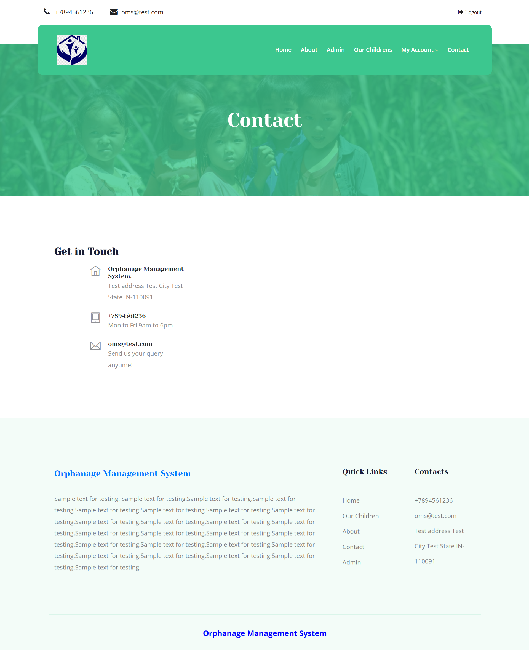

Slide 22
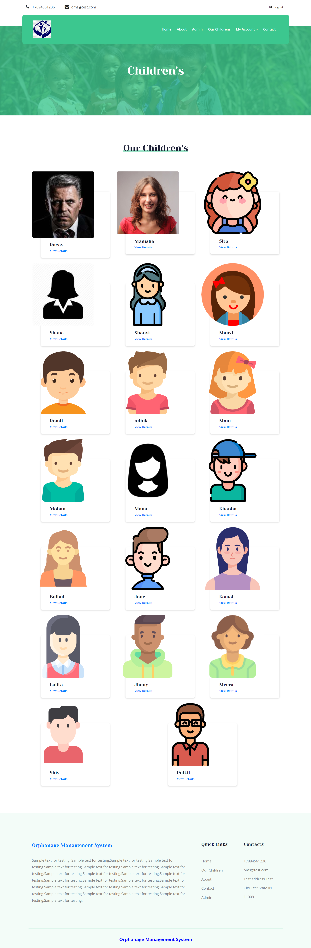

Slide 23
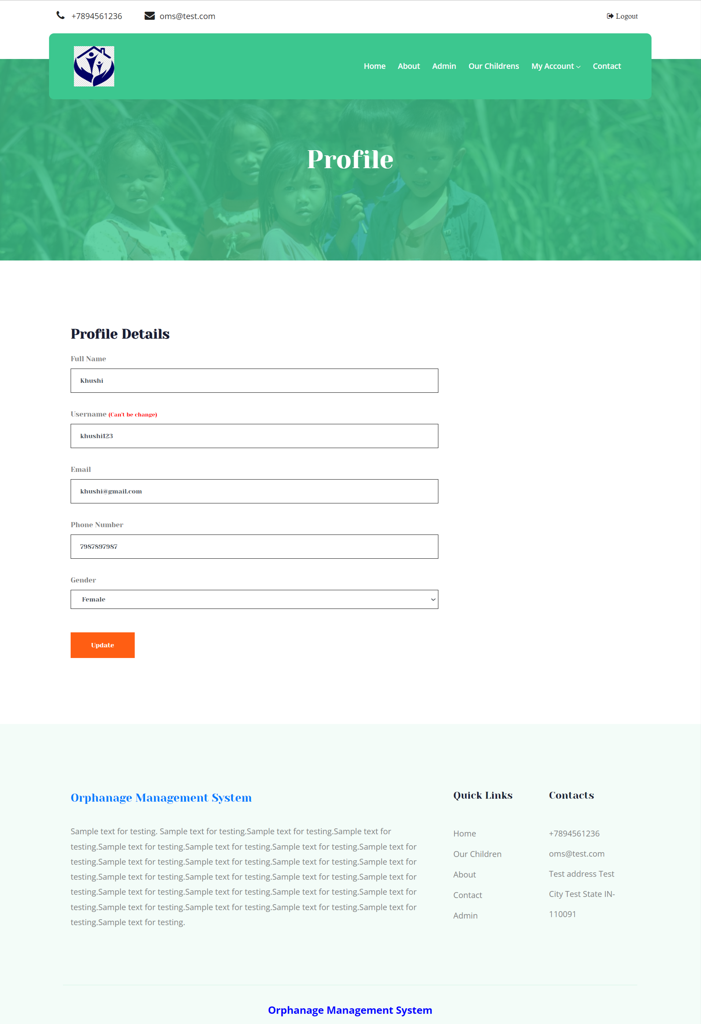

Slide 24
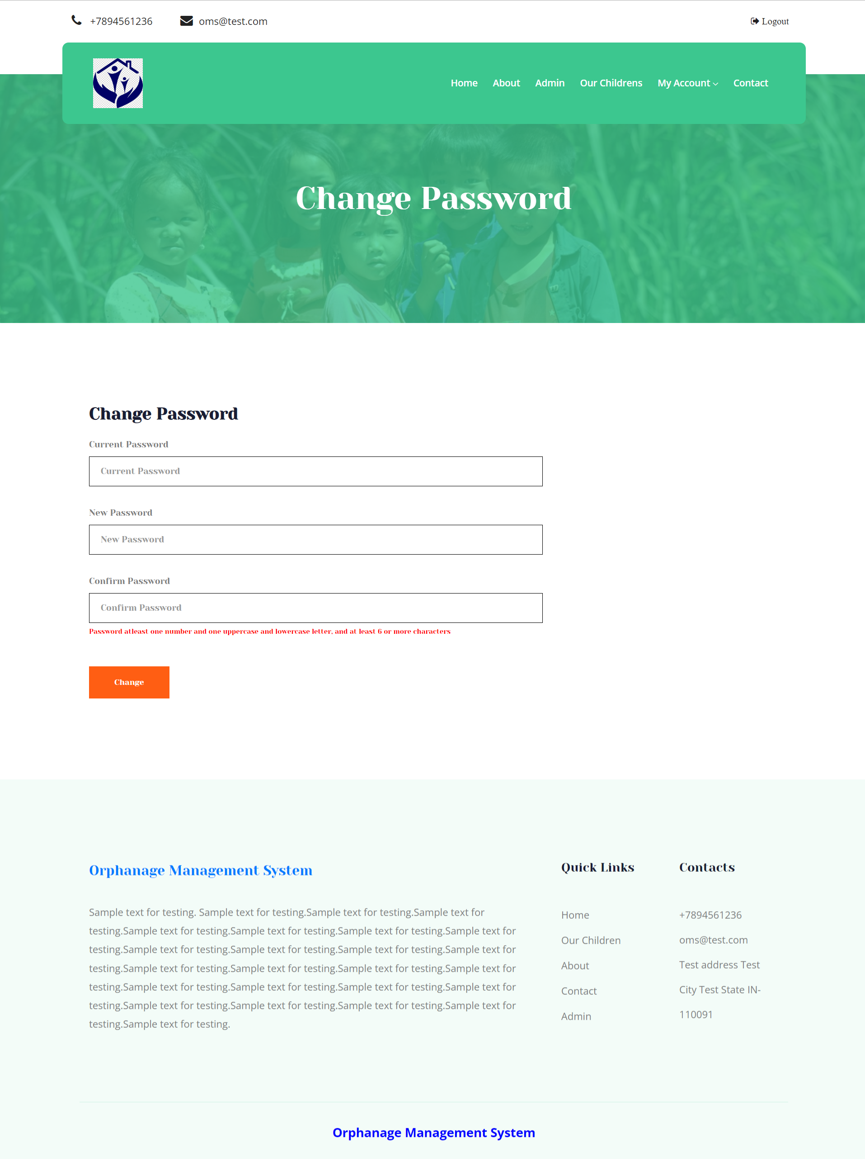

Slide 25
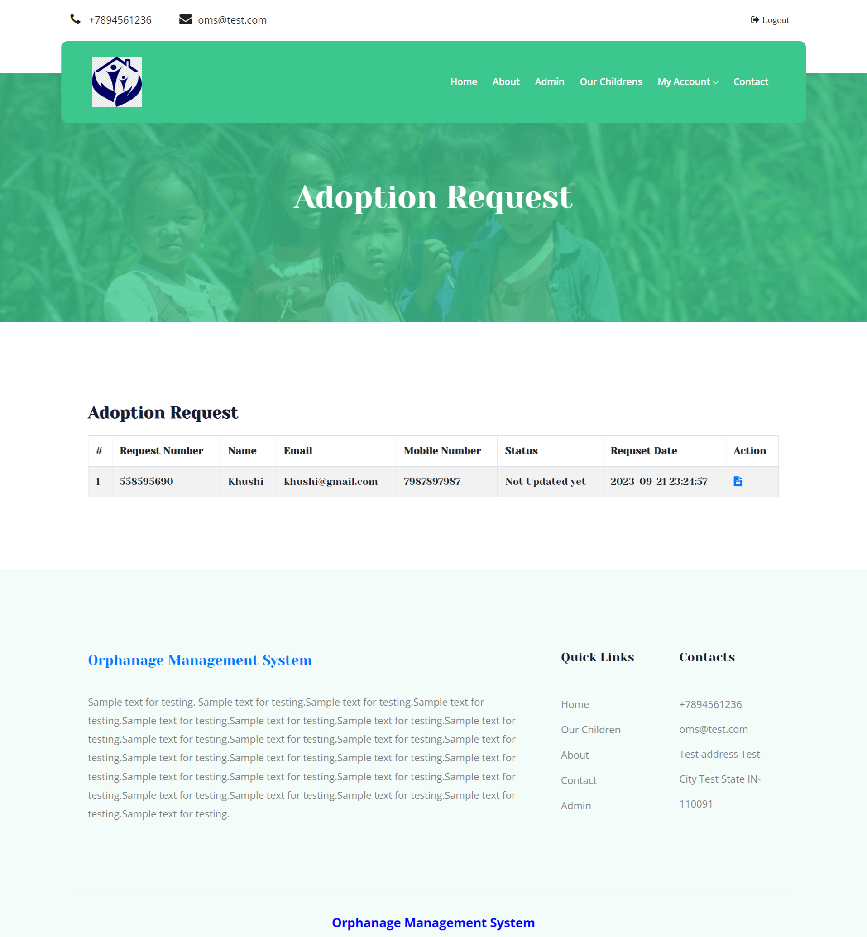

Slide 26
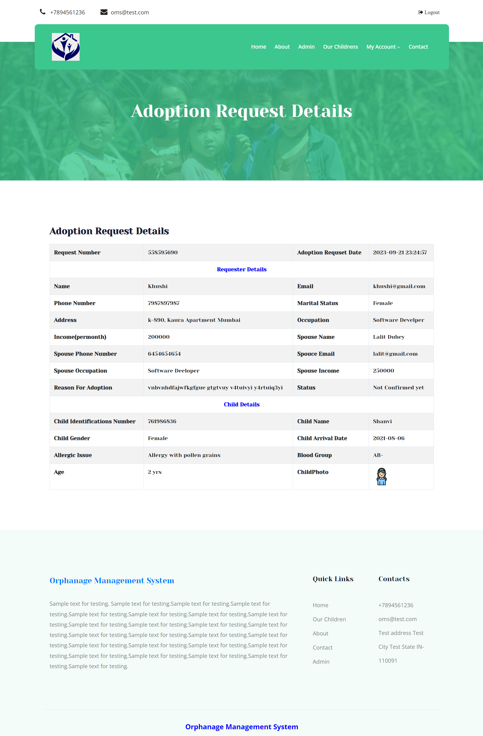

Slide 27
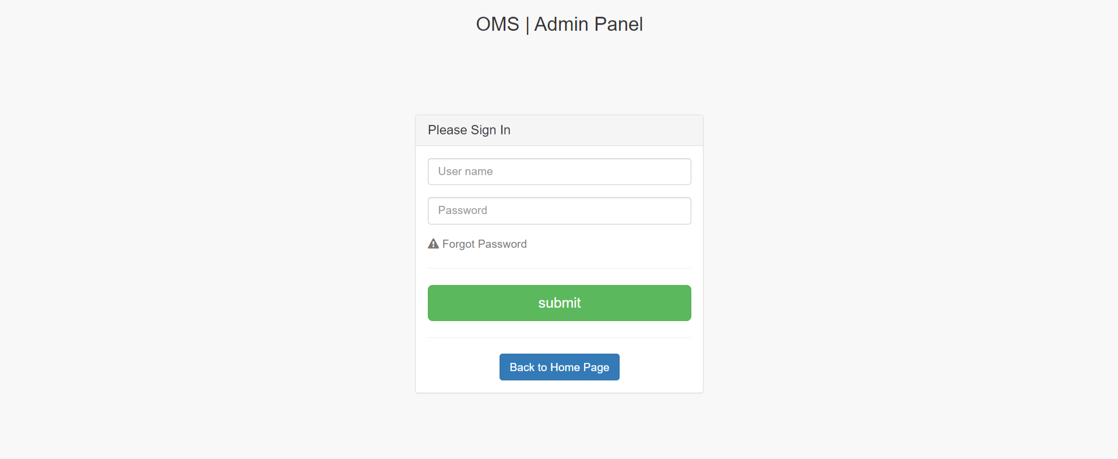
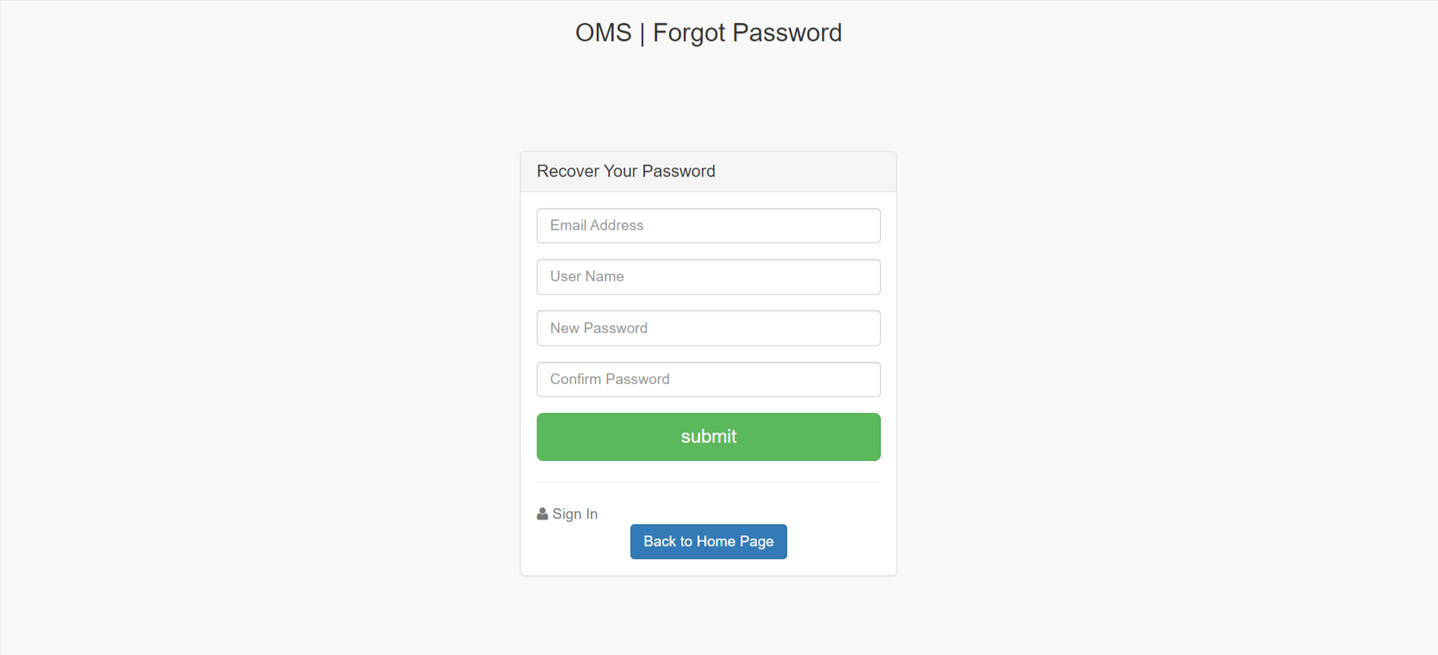

Slide 28
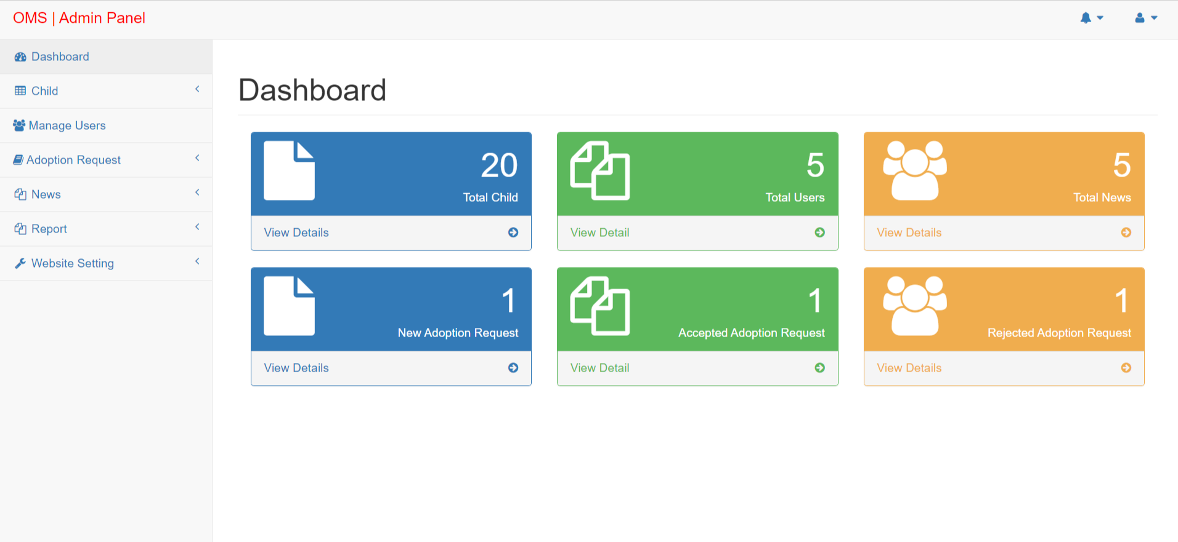
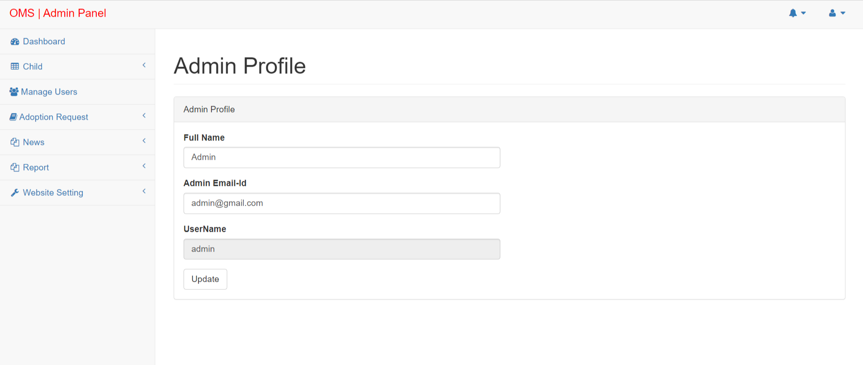

Slide 29
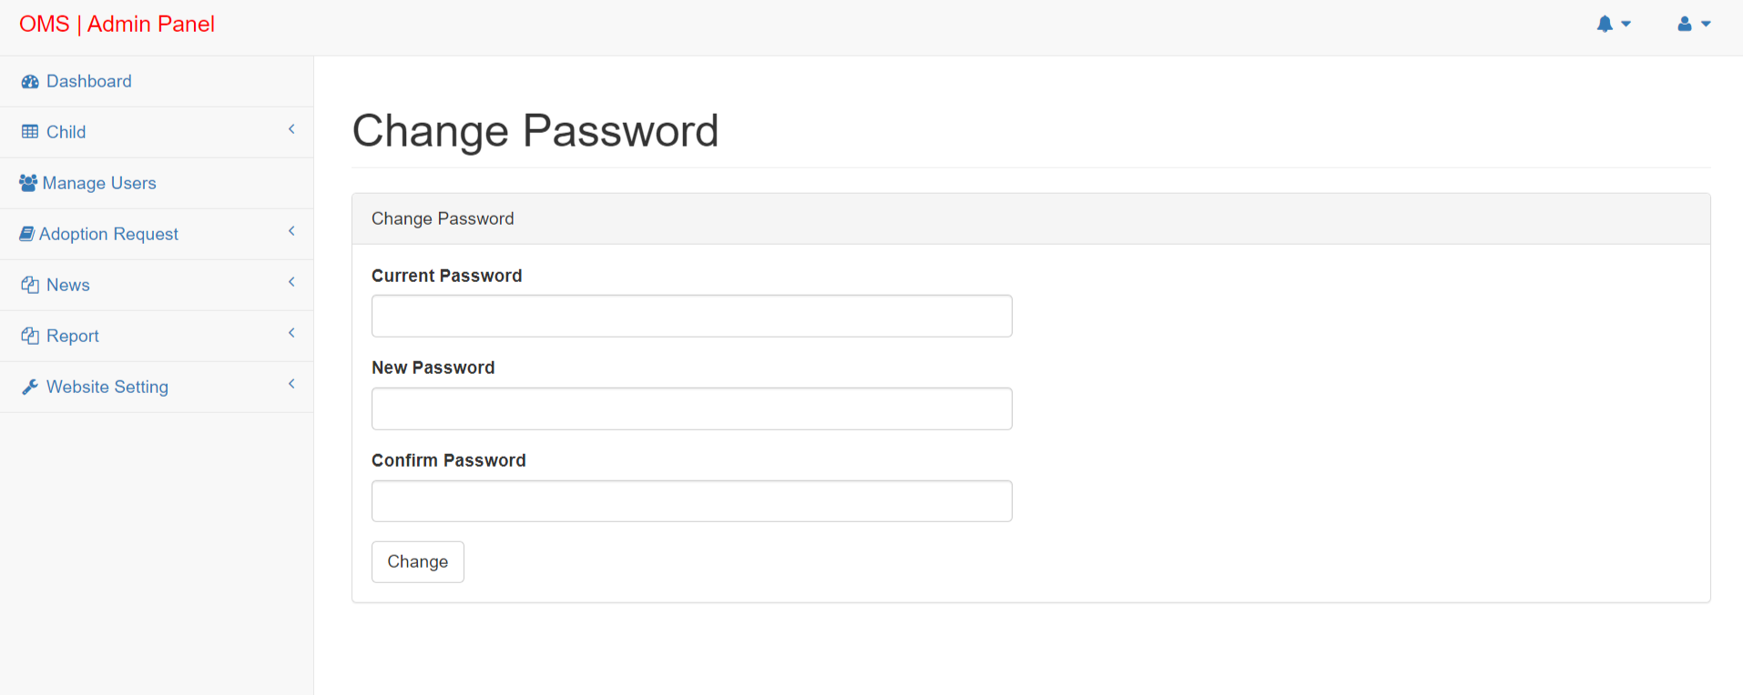
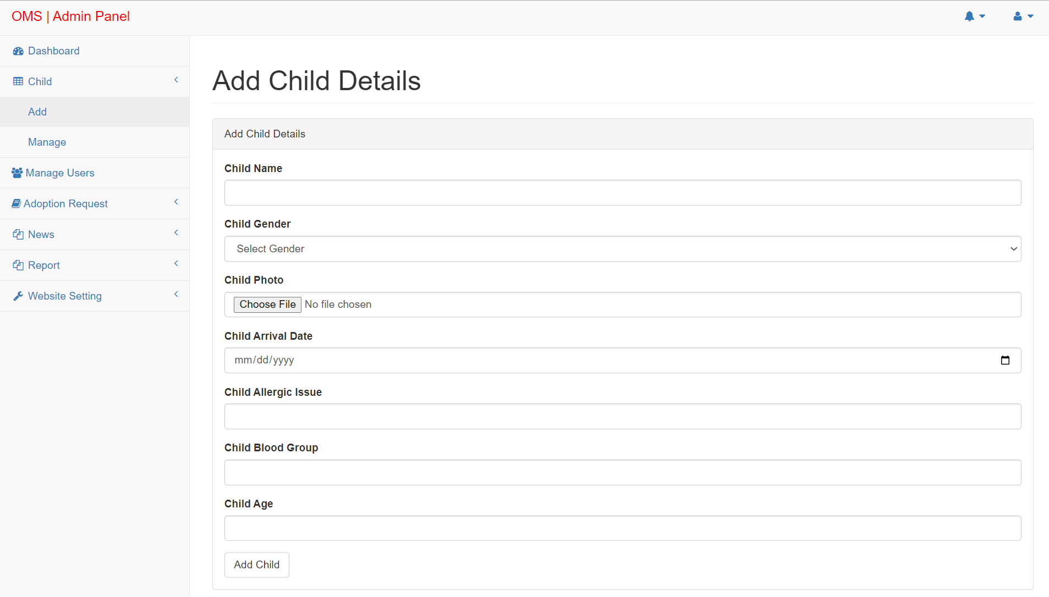

Slide 30
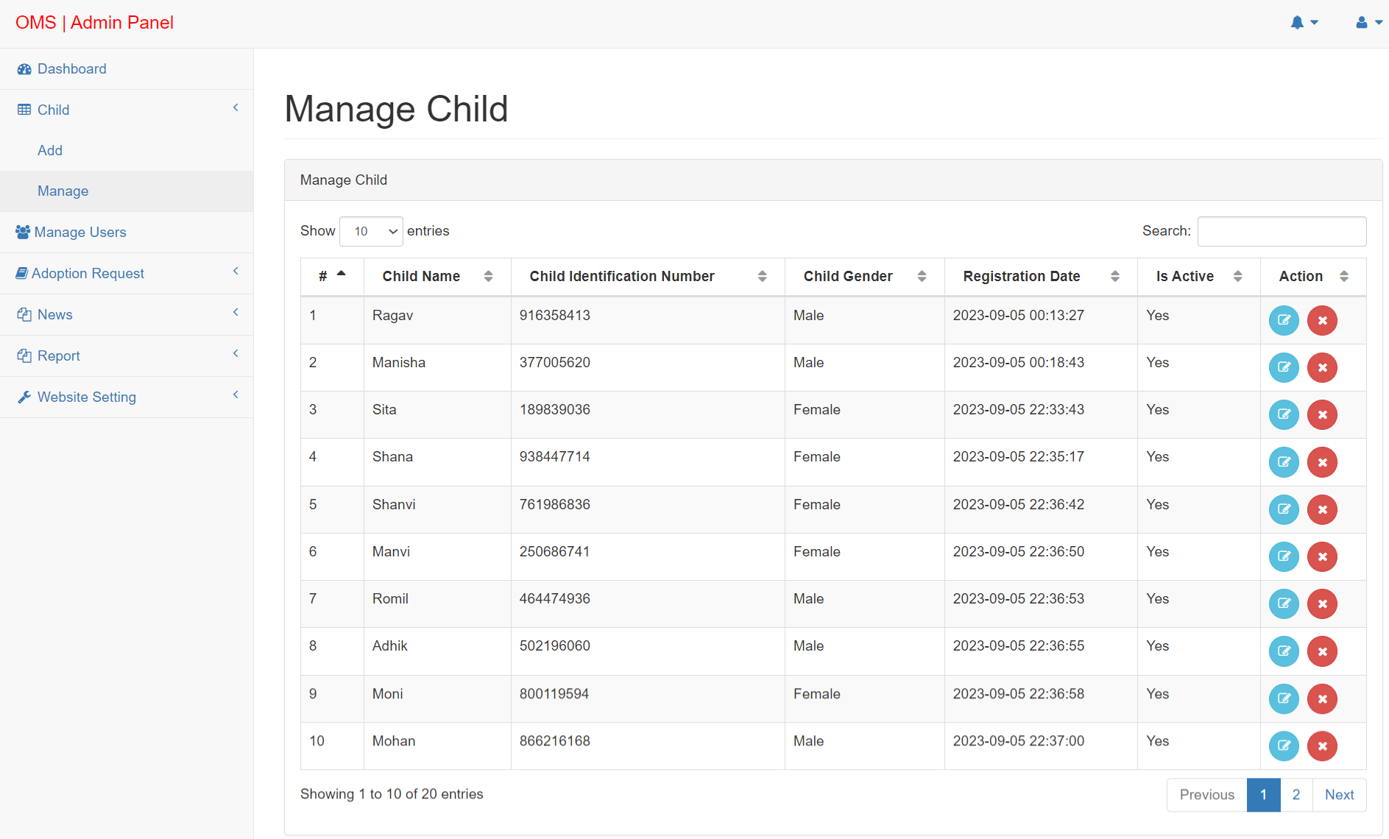
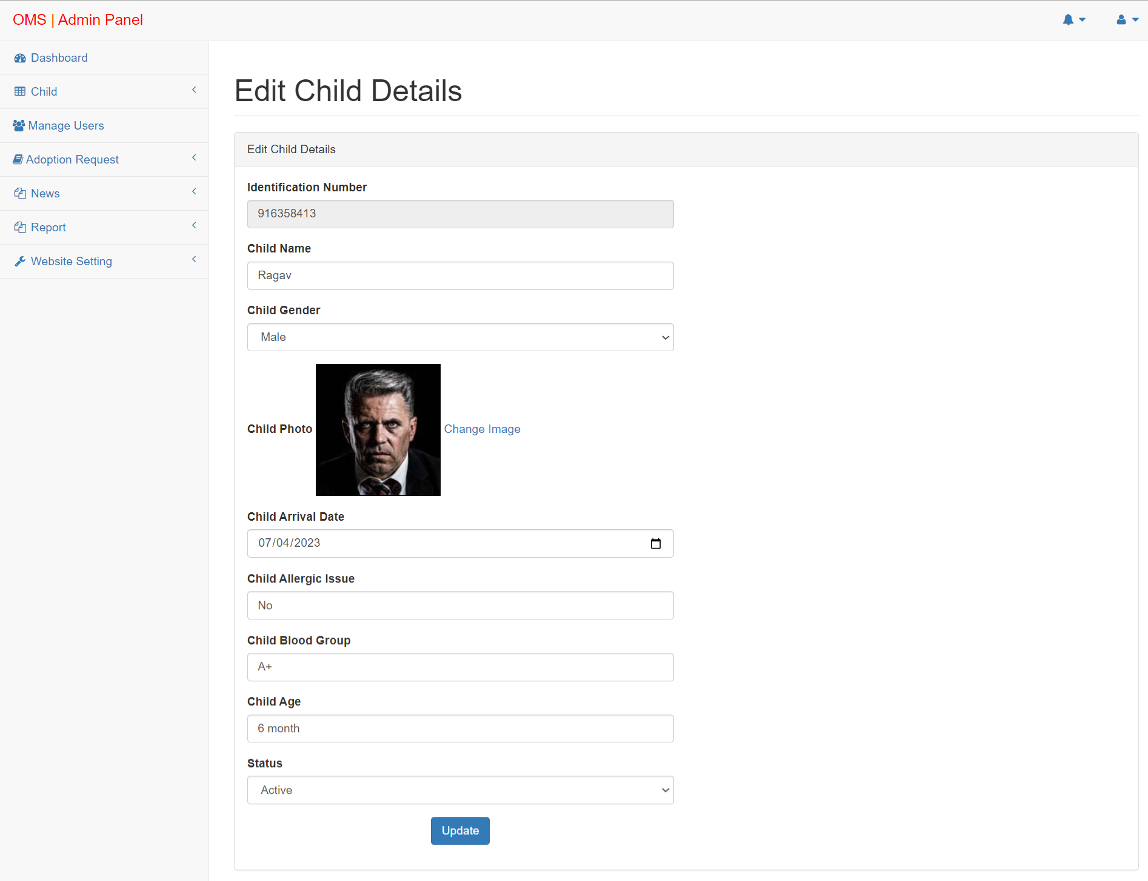

Slide 31
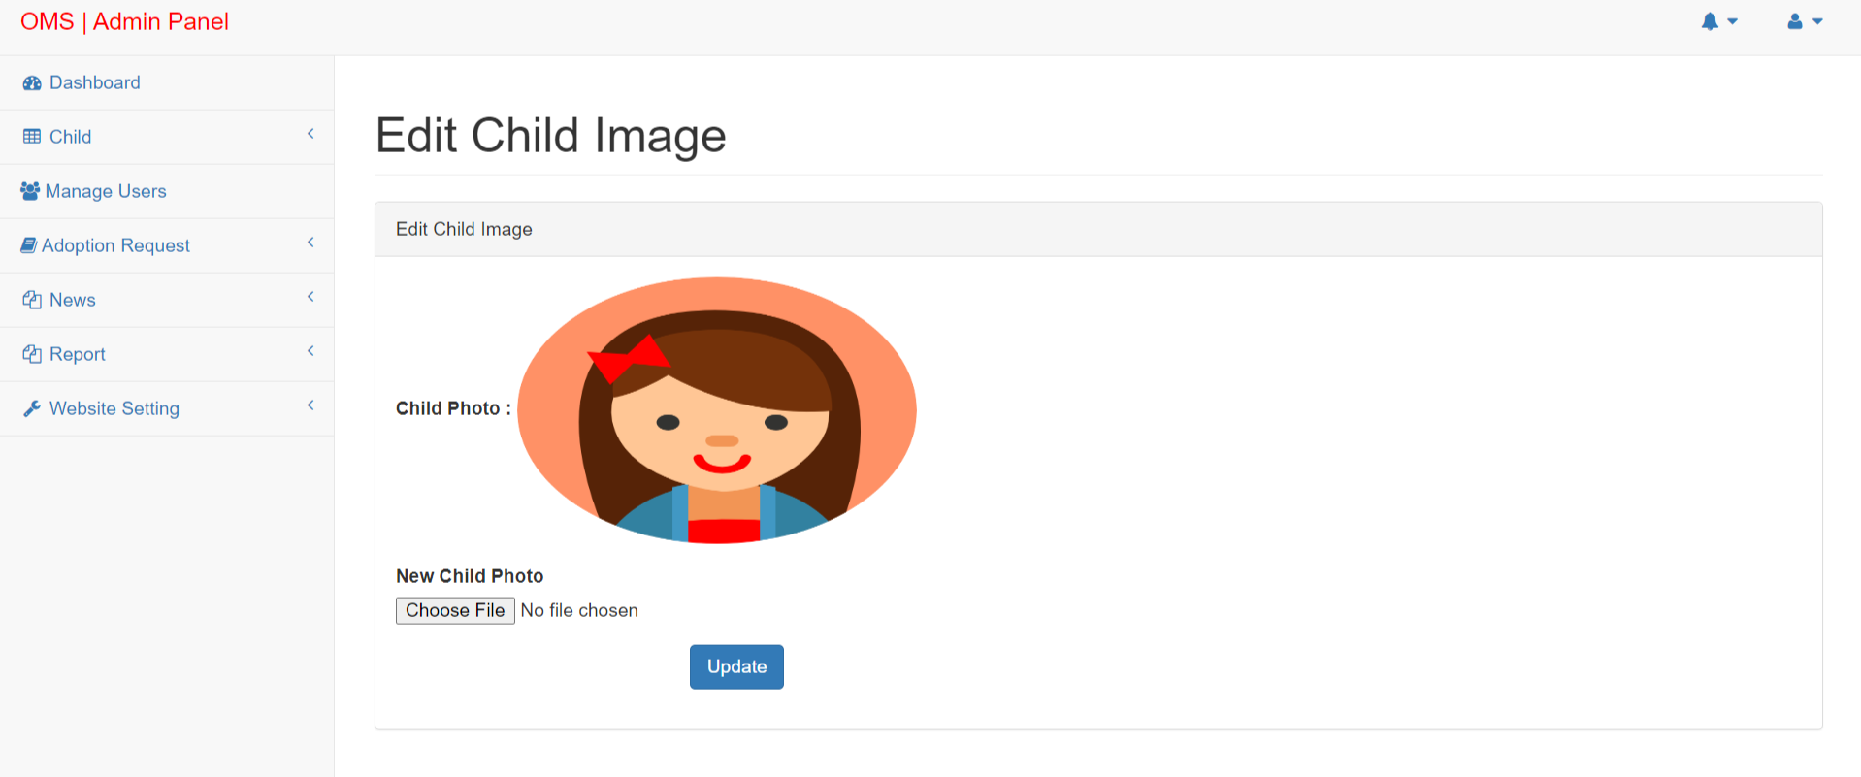
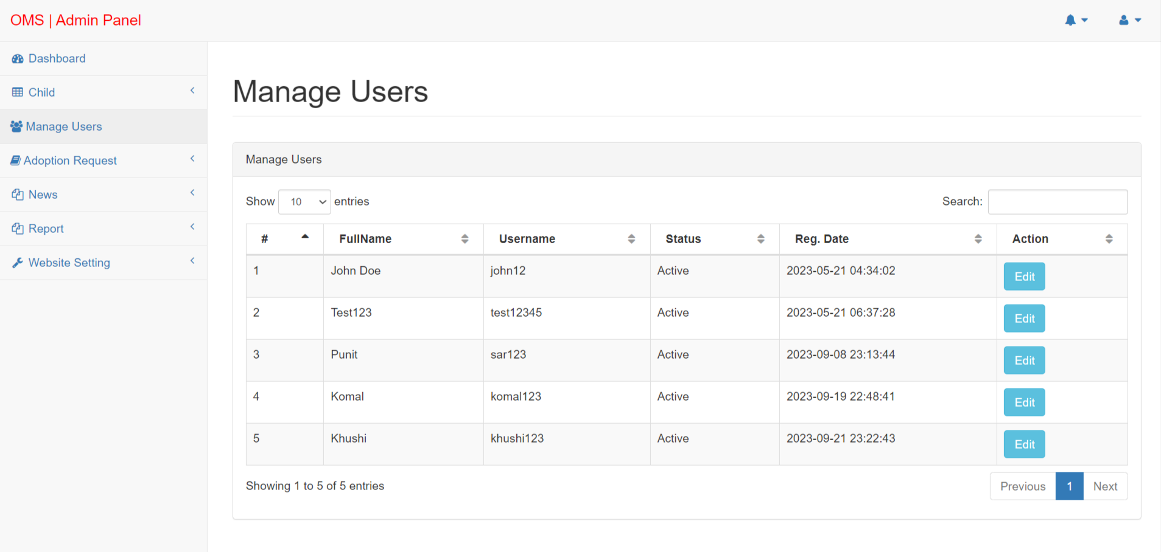

Slide 32
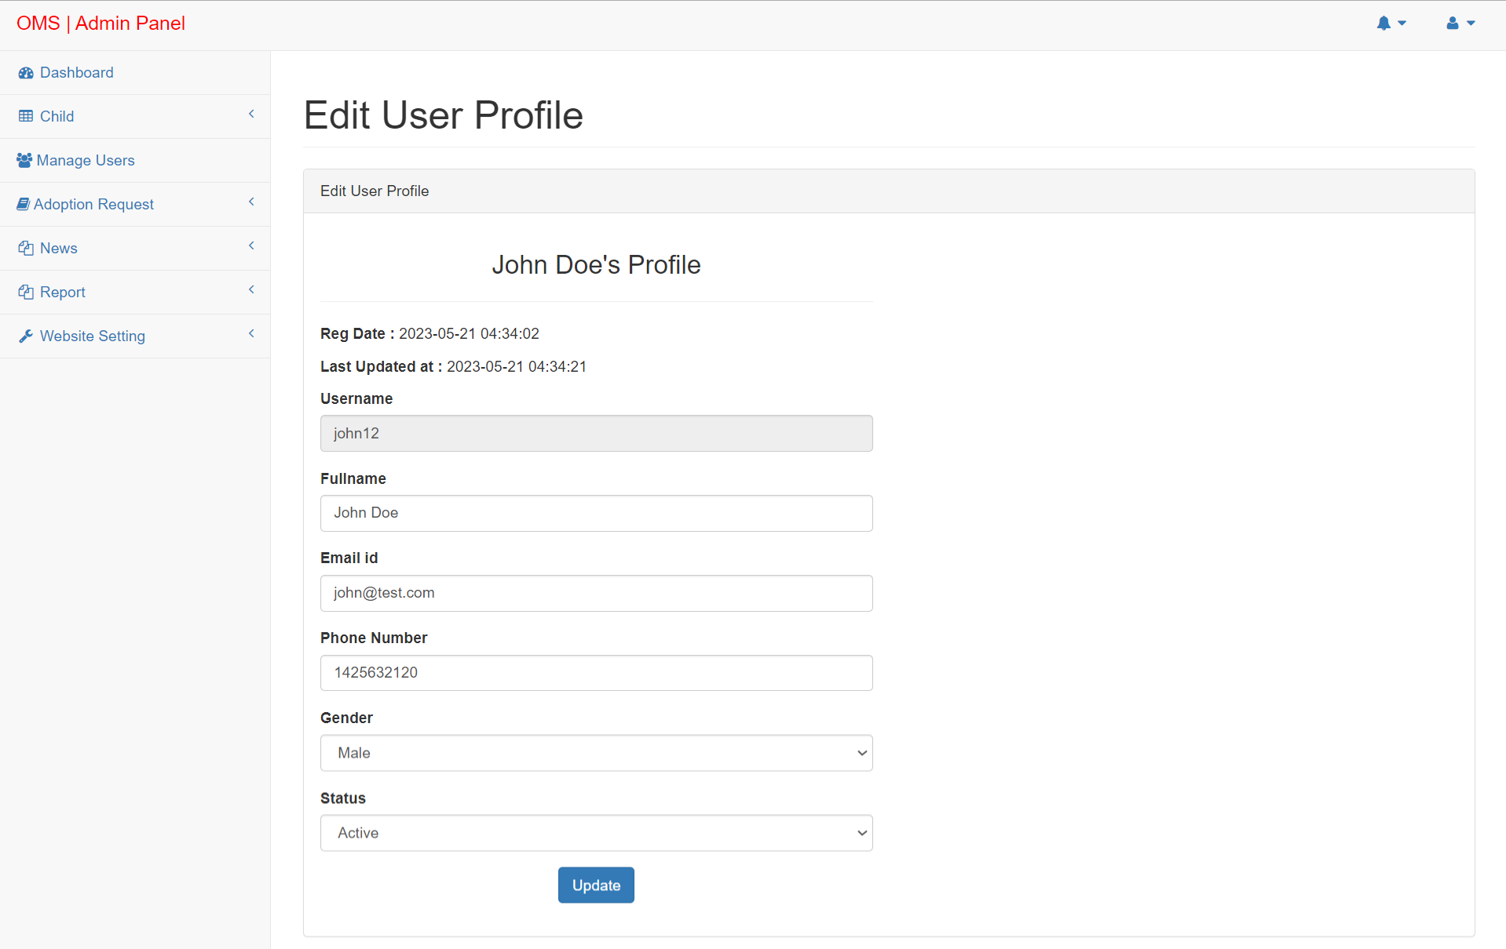
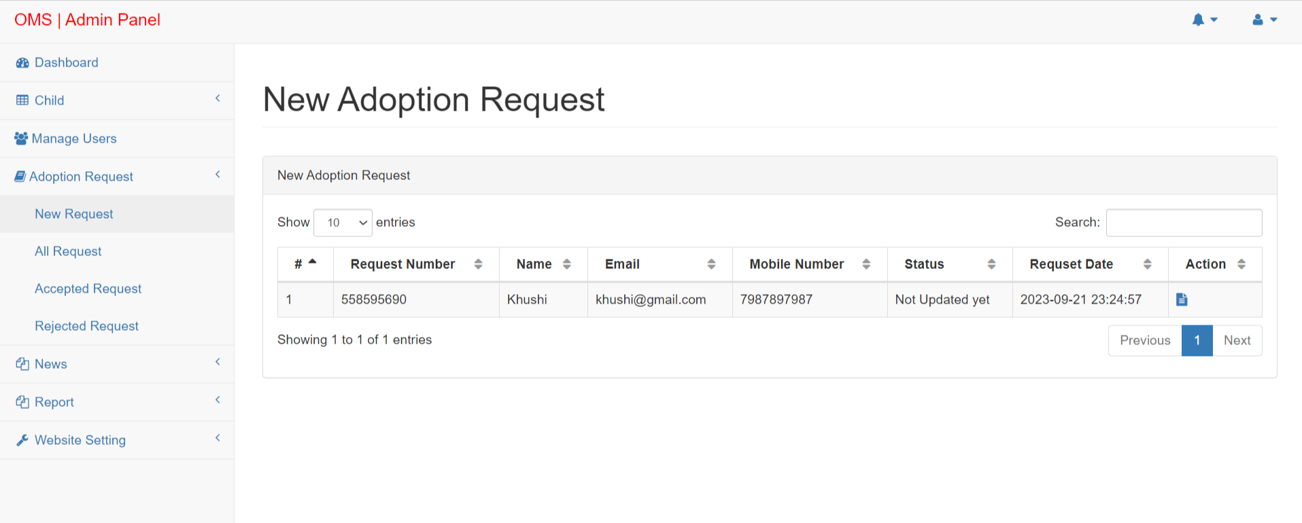

Slide 33
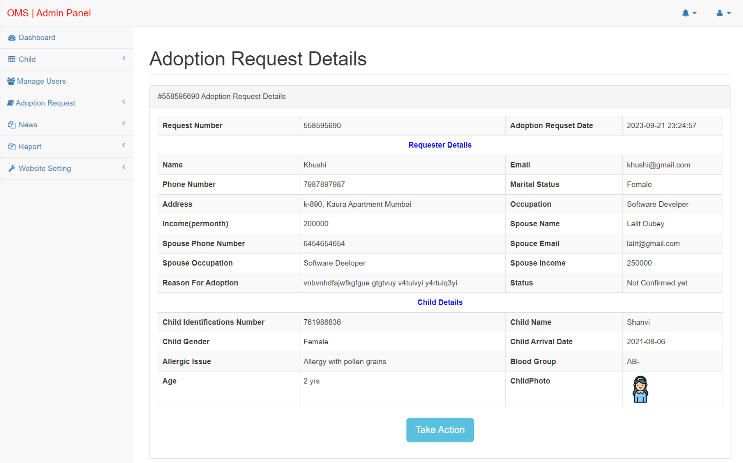
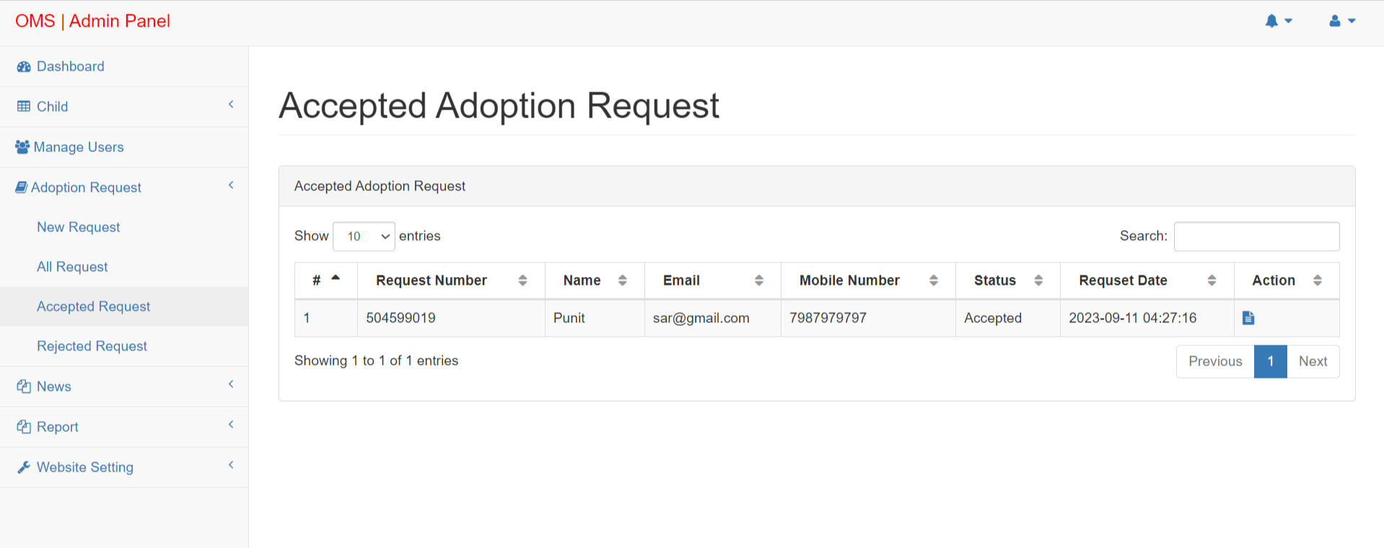

Slide 34
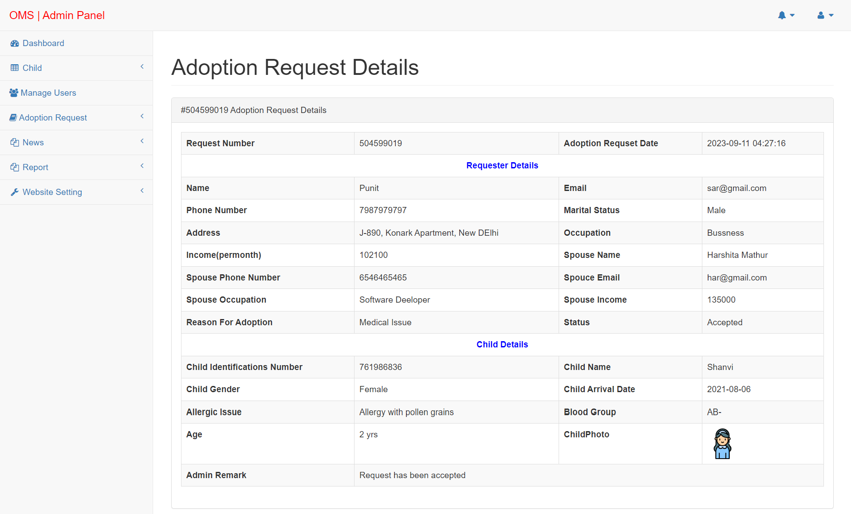
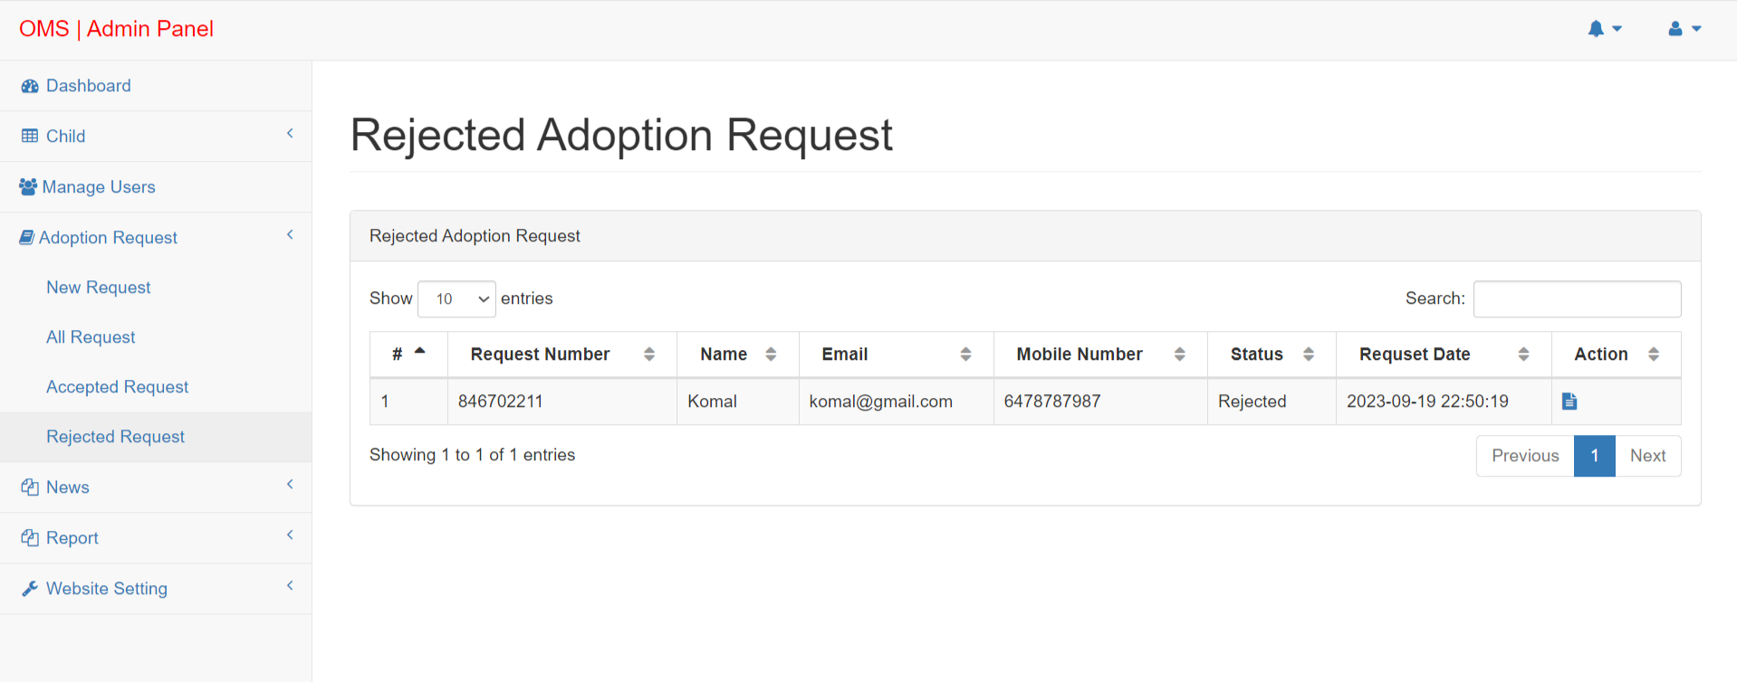

Slide 35
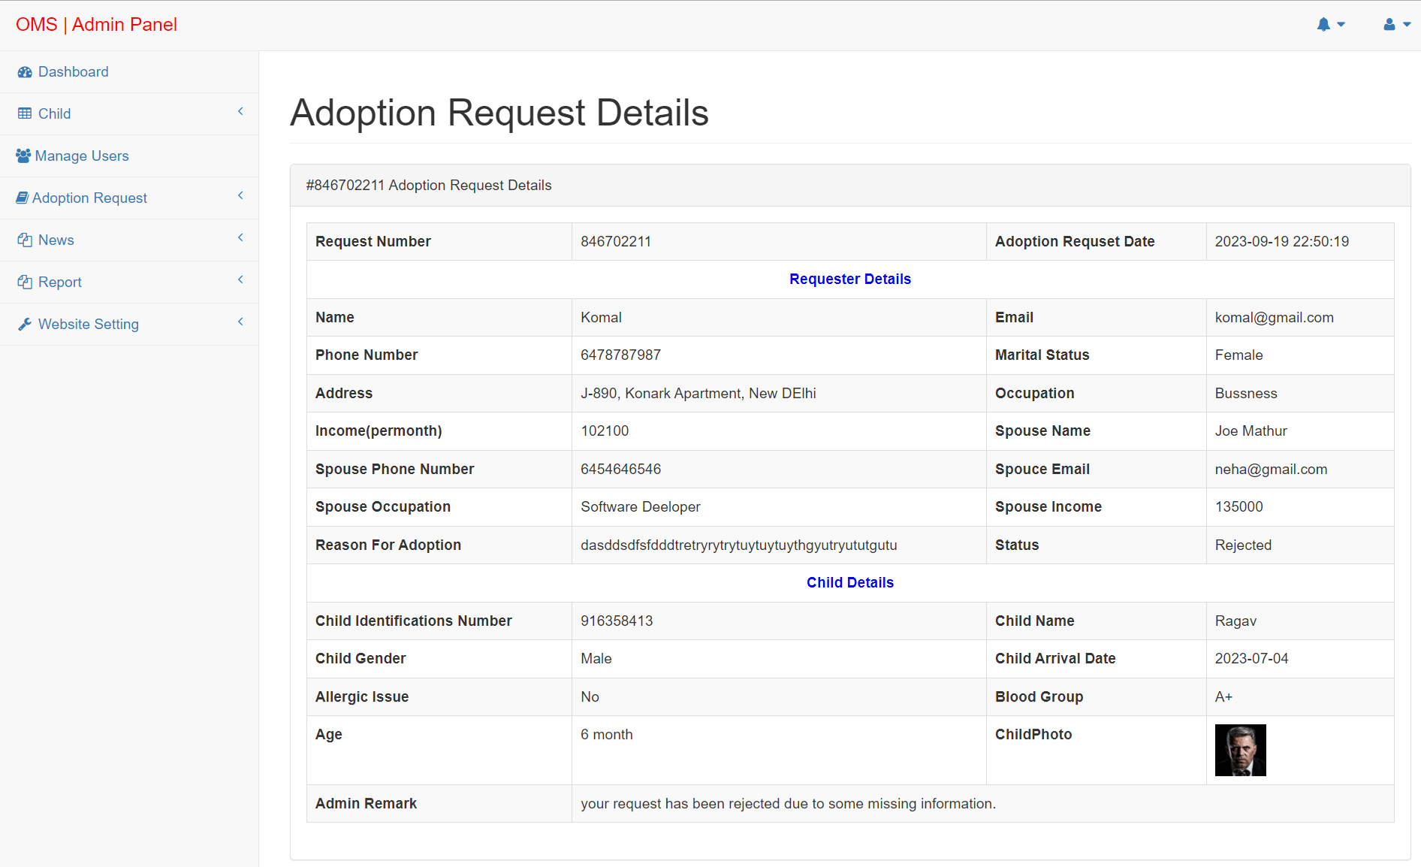
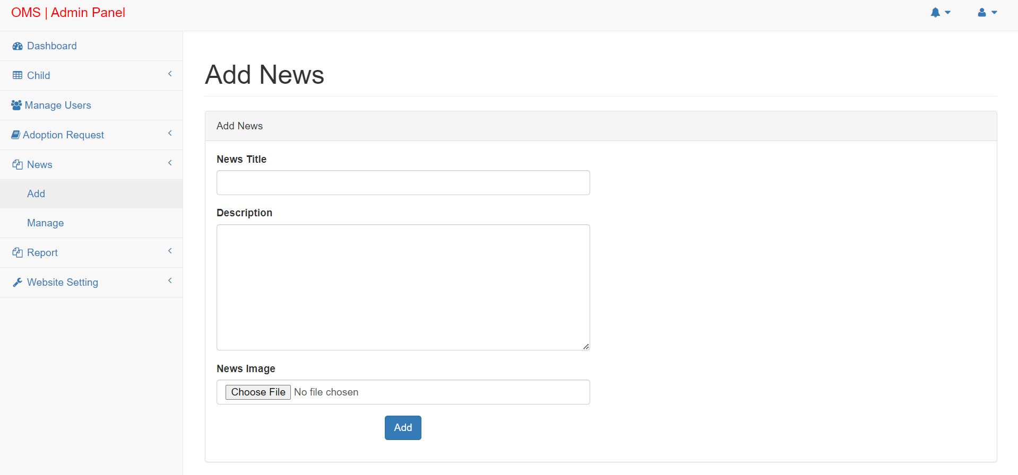

Slide 36
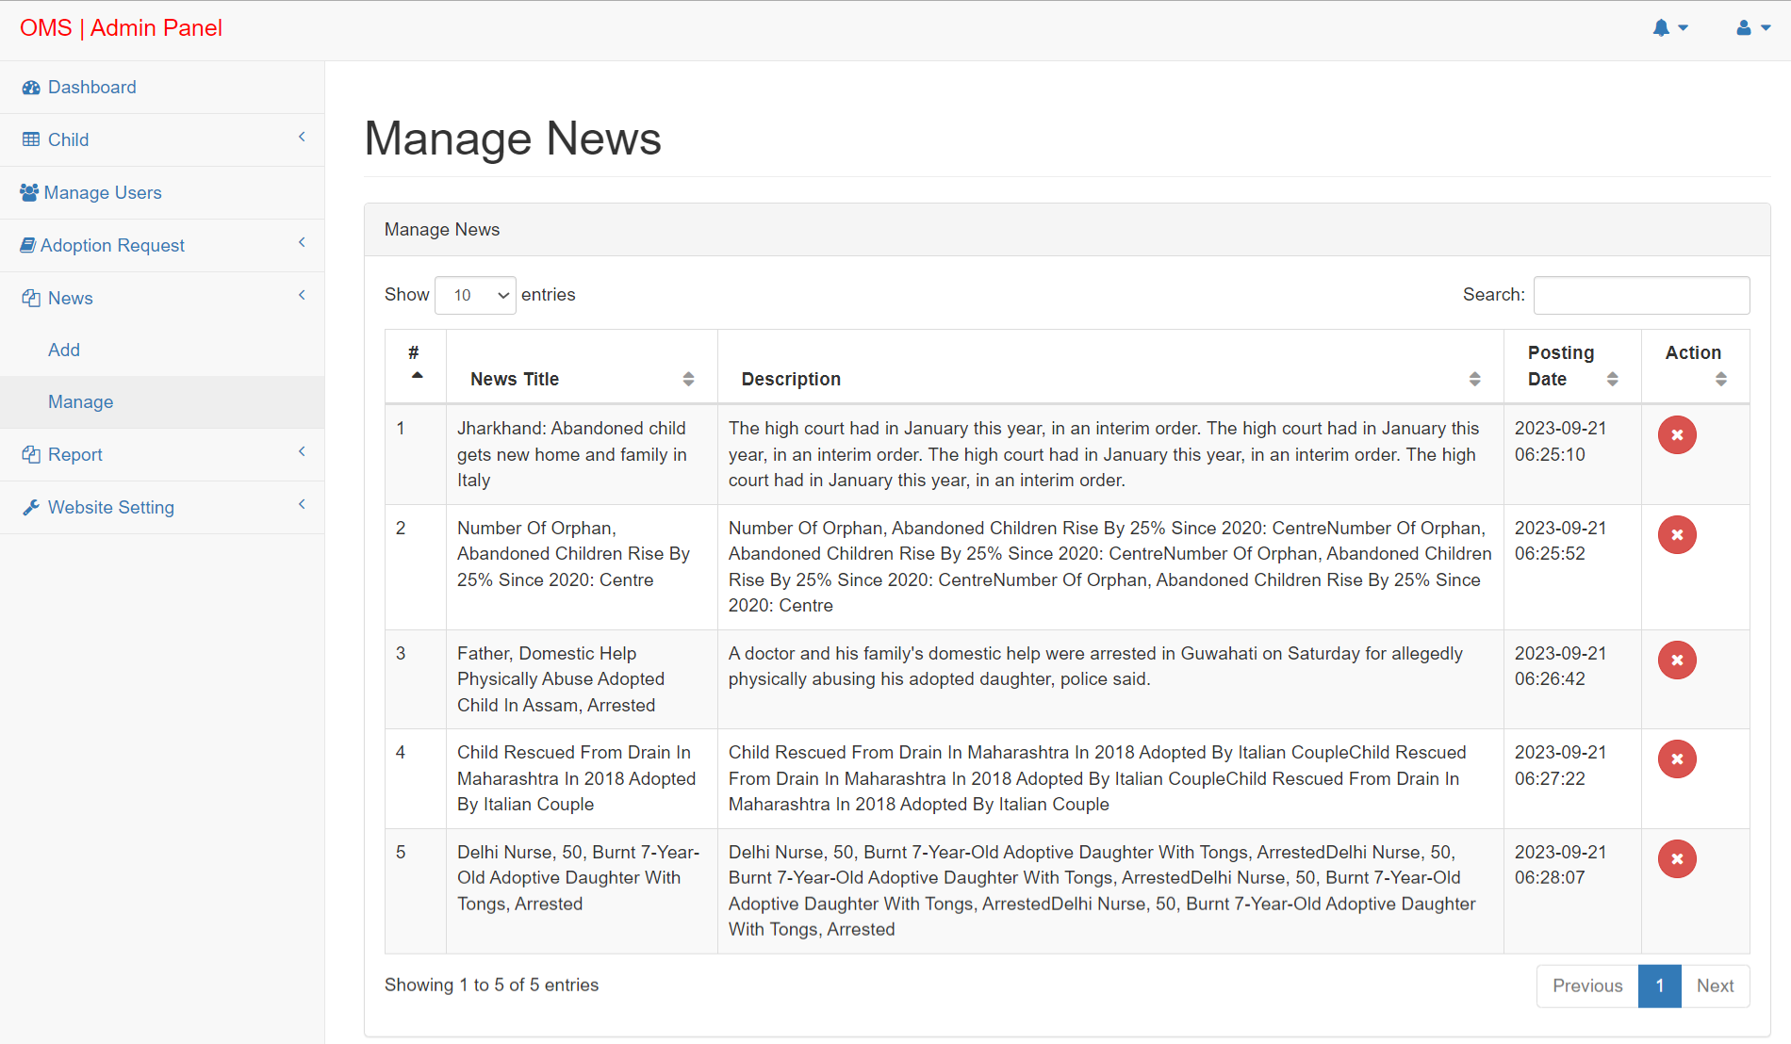
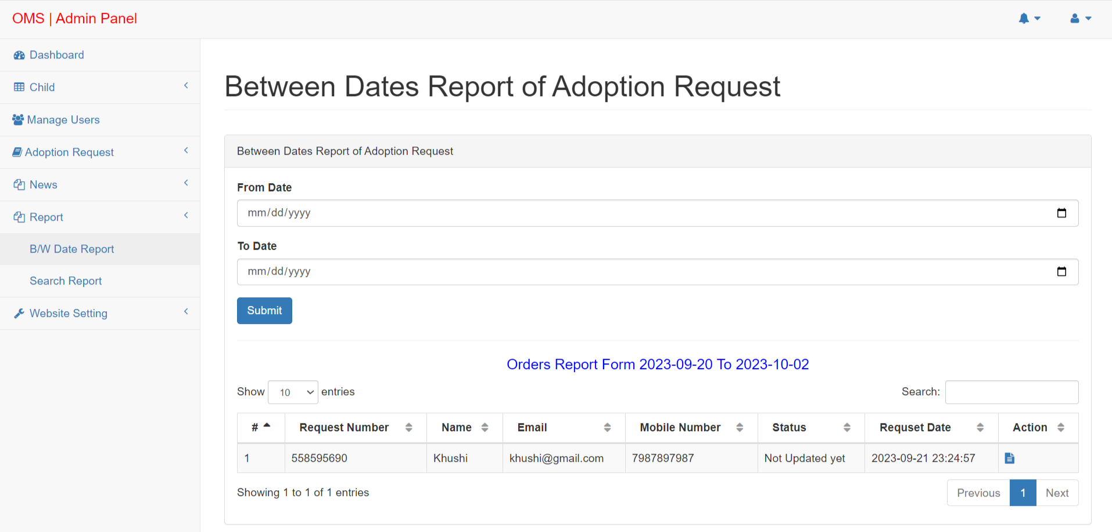

Slide 37
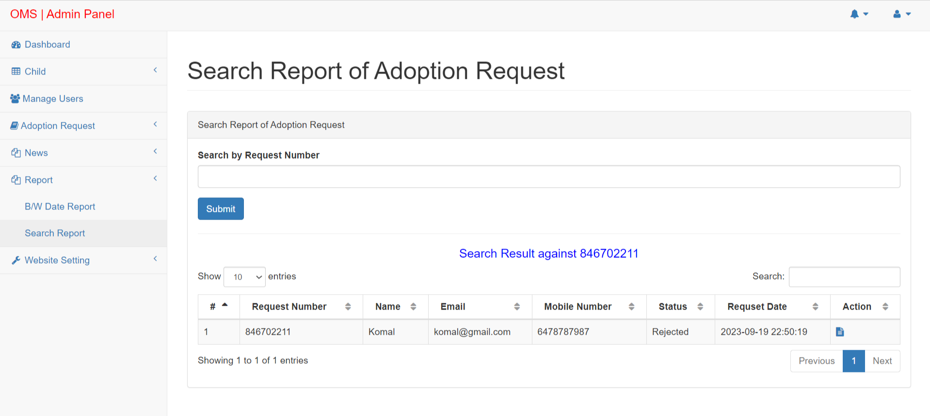
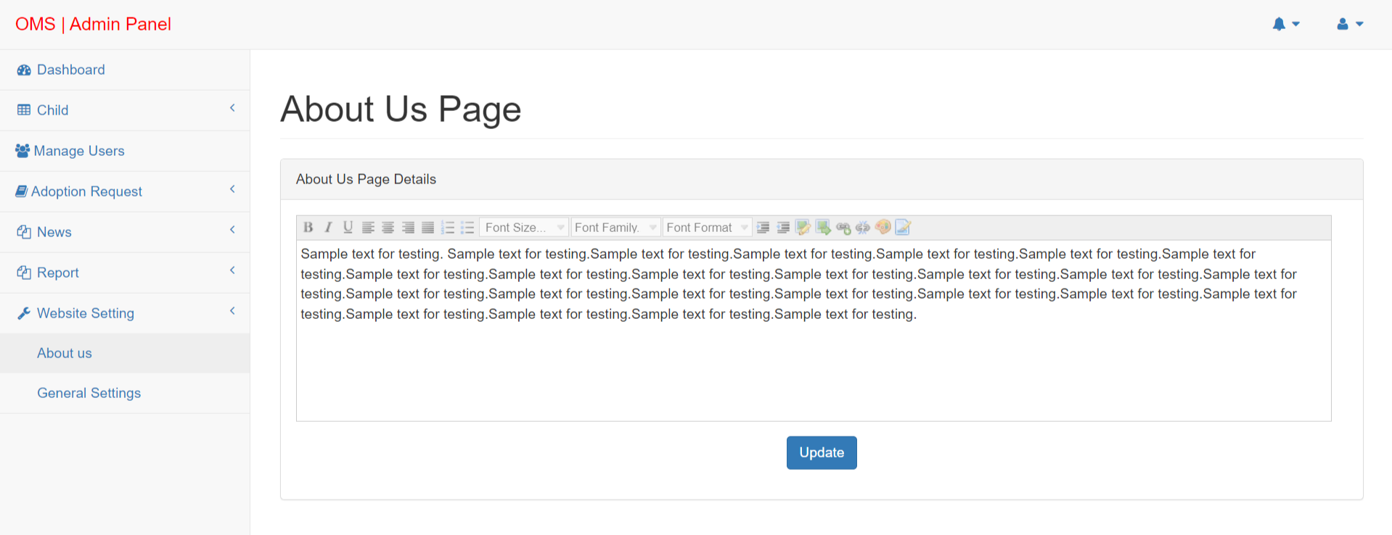

Slide 38
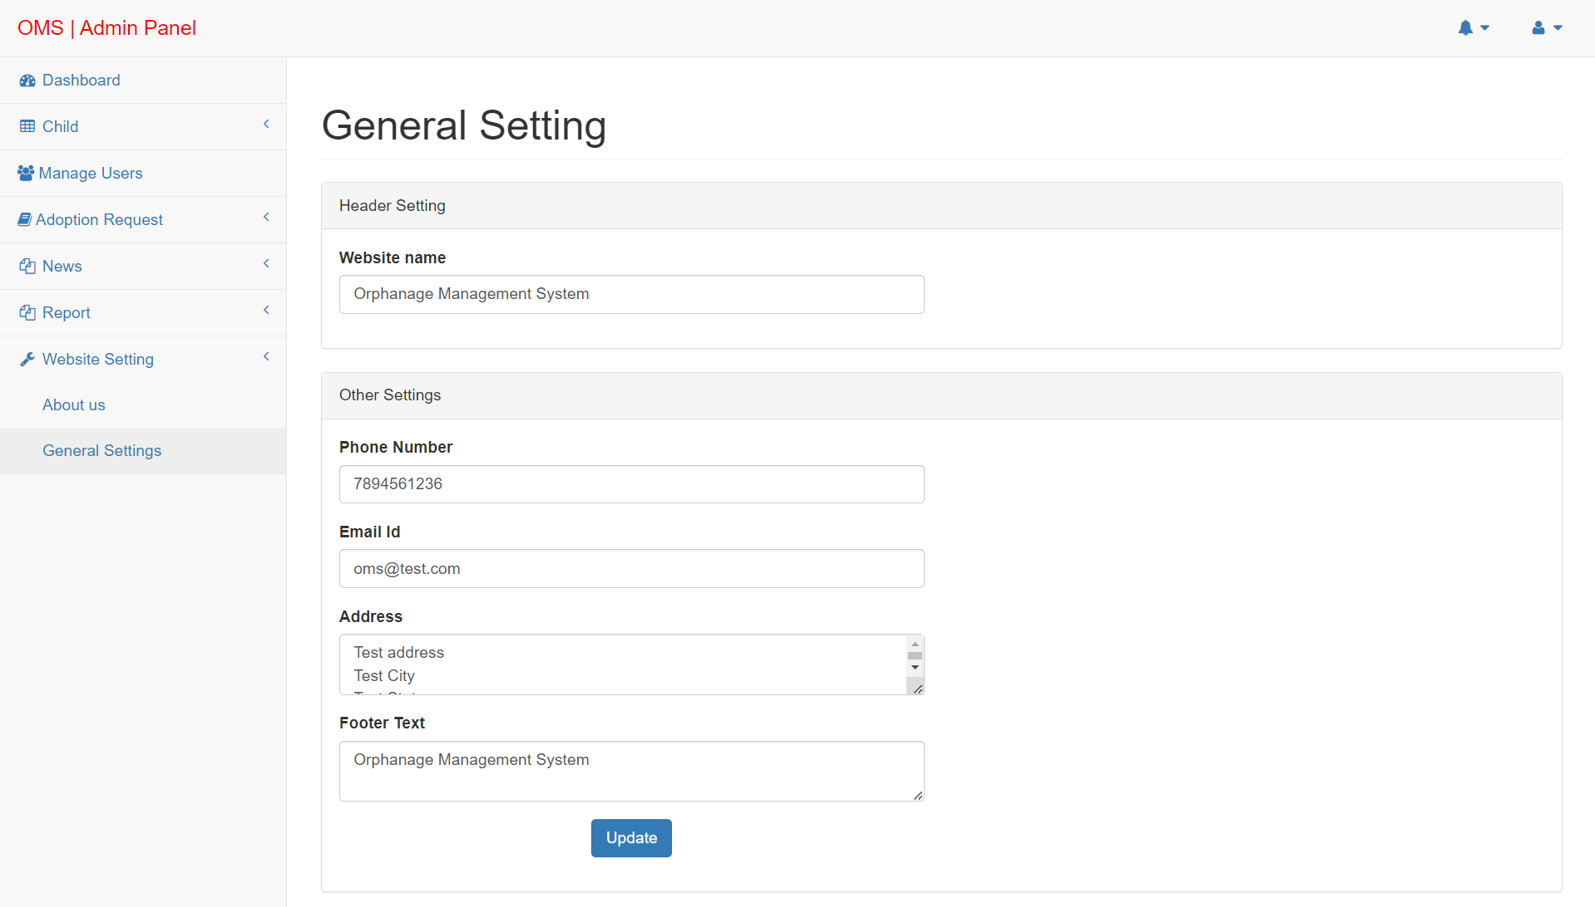

Slide 39
Conclusion
The project titled as Orphanage Management System was deeply studied and analyzed to design the code and implement. It was done under the guidance of the experienced project guide. All the current requirements and possibilities have been taken care during the project time.
Computer has got clear advantage over the manual system. The computerized system is more reliable, efficient and fast at the end of the project, I can say that computer play a very crucial role in the development of firm. All the daily reports generated by the system are to be checked by the concerned official so as to ensure that all the transactions have been put through in appropriate accounts and this is tallied with the new vouchers. Computer does maximum work with in minimum time. Because it is used in every field so that it provides comfort and suitability to everyone. Providing maximum facilities and comfort to customers to customers is main goal of the firm. To achieve this goal, other modern facilities relating to computer should have to be provided.

Slide 40
Bibliography
For PHP
https://www.w3schools.com/php/default.asp
https://www.sitepoint.com/php/
https://www.php.net/
For MySQL
https://www.mysql.com/
http://www.mysqltutorial.org
For XAMPP
https://www.apachefriends.org/download.html

Slide 41
Thank You

